Slide 1
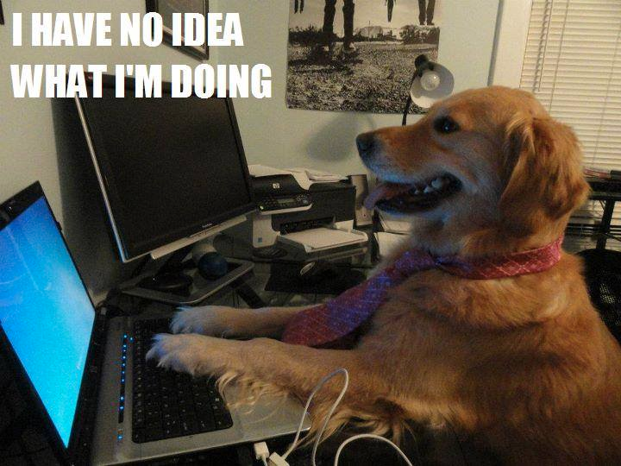
Heuristic evaluation CSCI 5839 Fall 2014
Notes:
http://media-cache-ec0.pinimg.com/236x/c2/a5/86/c2a58664f589a2447dcb6ca6111e5226.jpg

Slide 2
Today
More on Norman
Other perspectives on design
Discount usability testing and heuristic evaluation

Slide 3
Assignments
Today: peer feedback on Team Project 2 (personas, scenarios, sketches)
Thursday: Paper prototypes and user testing plan
By end of semester: 3 one-page sketching assignments (http://shaunkane.info/classes/csci5839/assignments/sketch.html)

Slide 4
Norman scavenger hunt
Most items: Jake & Odie (23)

Slide 5
Some interesting items
Light switch (affordance? mapping? constraint?)
Wall clock (feedback vs. system status)
Color as convention
Clicker signs (mapping?)
Backpack?
Chalk?
Projector

Slide 6
High level view of class
First: understanding users
Second: designing, sketching, expressing ideas
Now: best practices for user interface design; evaluation techniques

Slide 7
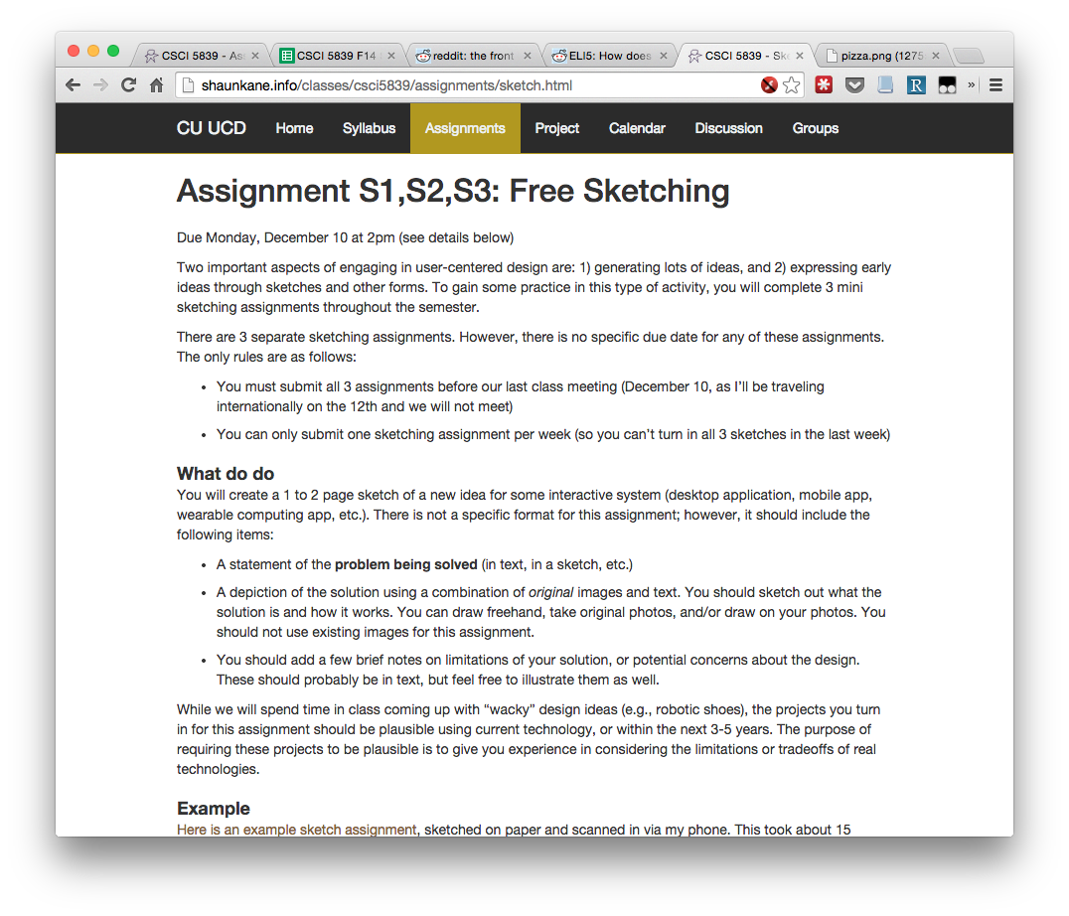

Slide 8
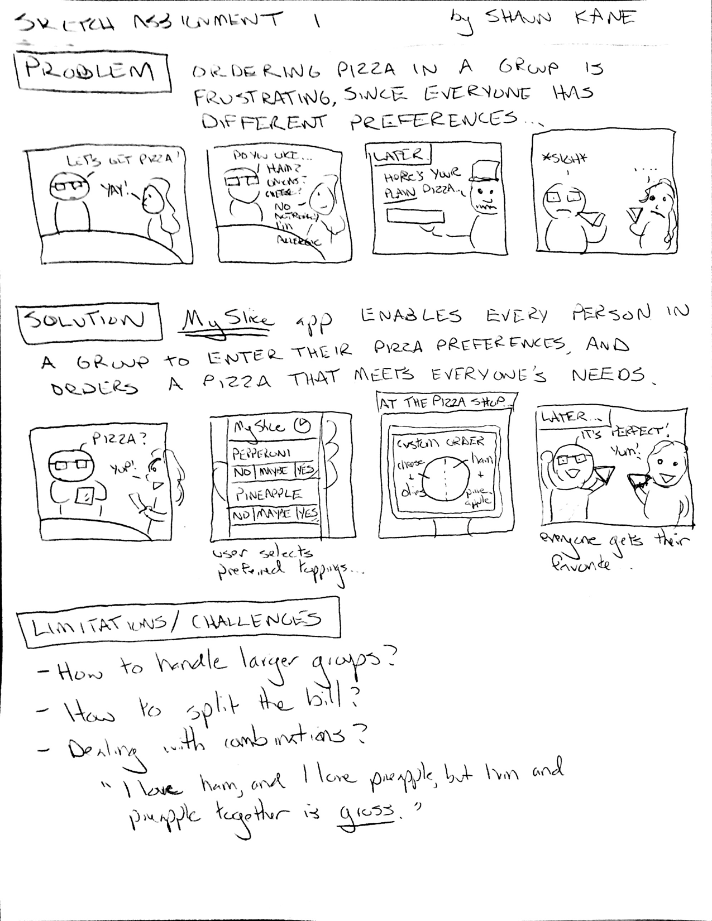

Slide 9
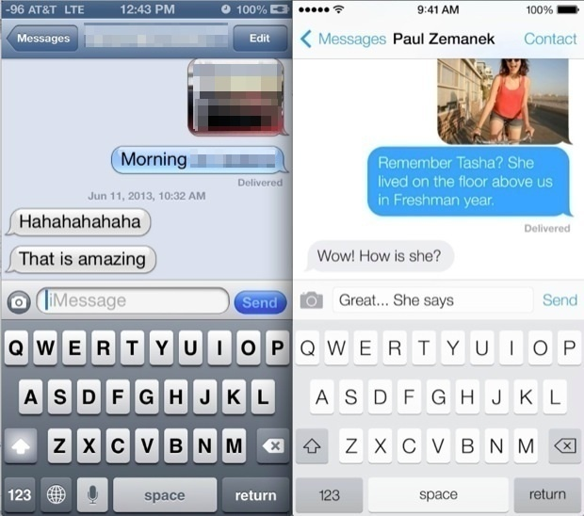
Balancing usability with visual design
Notes:
http://cdn.osxdaily.com/wp-content/uploads/2013/06/messages-ios-6-vs-7.jpeg
http://core0.staticworld.net/images/article/2014/03/ios71-buttonshapes-100249680-medium.png

Slide 10
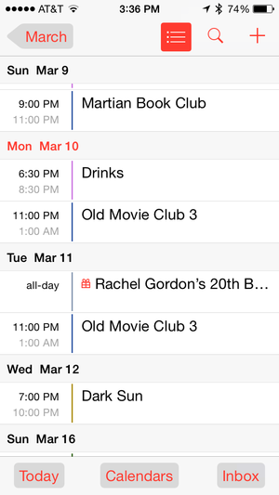
Balancing usability with visual design
Notes:
http://cdn.osxdaily.com/wp-content/uploads/2013/06/messages-ios-6-vs-7.jpeg
http://core0.staticworld.net/images/article/2014/03/ios71-buttonshapes-100249680-medium.png

Slide 11
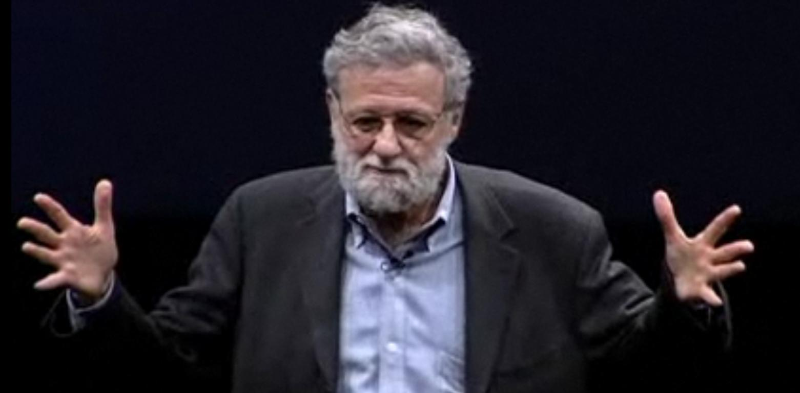
Norman on affordances
http://www.jnd.org/dn.mss/affordances_and.html
Notes:
http://www.jennifercluff.com/blog/uploaded_images/norman-744159.JPG

Slide 12
Norman on affordances (2)
The word "affordance" was originally invented by the perceptual psychologist J. J. Gibson (1977, 1979) to refer to the actionable properties between the world and an actor (a person or animal). To Gibson, affordances are a relationship. They are a part of nature: they do not have to be visible, known, or desirable. Some affordances are yet to be discovered. Some are dangerous. I suspect that none of us know all the affordances of even everyday objects.

Slide 13
Norman on affordances (3)
I introduced the term affordance to design in my book [DOET]. The concept has caught on, but not always with true understanding. Part of the blame lies with me: I should have used the term "perceived affordance," for in design, we care much more about what the user perceives than what is actually true. What the designer cares about is whether the user perceives that some action is possible (or in the case of perceived non-affordances, not possible).

Slide 14
Norman on affordances (4)
In product design, where one deals with real, physical objects, there can be both real and perceived affordances, and the two need not be the same. In graphical, screen-based interfaces, all that the designer has available is control over perceived affordances. The computer system, with its keyboard, display screen, pointing device (e.g., mouse) and selection buttons (e.g., mouse buttons) affords pointing, touching, looking, and clicking on every pixel of the display screen. Most of this affordance is of no value. Thus, if the display does not have a touch-sensitive screen, the screen still affords touching, but it has no result on the computer system.

Slide 15
Norman on affordances (5)
In graphical design, one is really talking about conventions, or what I called logical and cultural "constraints" in POET. Physical constraints are closely related to real affordances: Thus, it is not possible to move the cursor outside the screen: this is a physical constraint. Logical constraints use reasoning to determine the alternatives. Thus, if we ask the user to click on 5 locations and only 4 are immediately visible; the person knows, logically, that there is still location left.

Slide 16
Norman on affordances (6)
In similar vein, because I can click anytime I want, it is wrong to argue whether a graphical object on the screen "affords clicking." It does. The real question is about the perceived affordance: Does the user perceive that clicking on that location is a meaningful, useful action to perform?

Slide 17
Norman: takeaways
Remember gulf of execution and evaluation
Affordances (what they are, what they are not, what they are useful for)
Feedback
Constraints
Mapping (natural and unnatural)
Conceptual models

Slide 18
What’s missing?
What do we not get from Norman?

Slide 19
What’s missing?
Aesthetics (Norman is all about practical, boring usability)
Testing methodology

Slide 20
Emotional Design (Norman, 2004)
Three levels of design
Visceral – raw emotional/physical experience
Behavioral – does it work the way I expect?
Reflective – how does using this affect my perception of myself, life, the universe, everything?

Slide 21
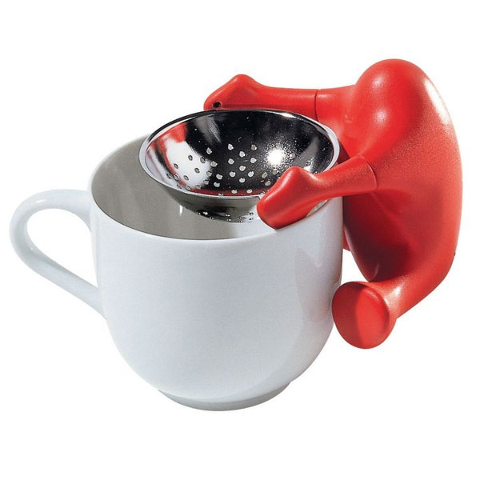
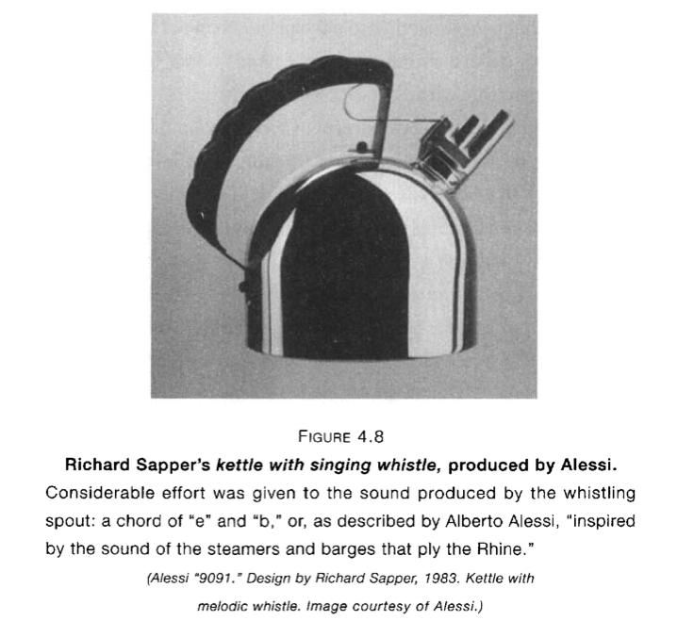
Playfulness and fun
Alessi tea strainer

Slide 22
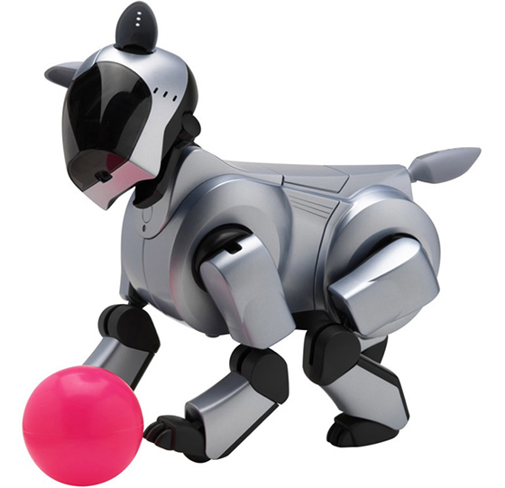
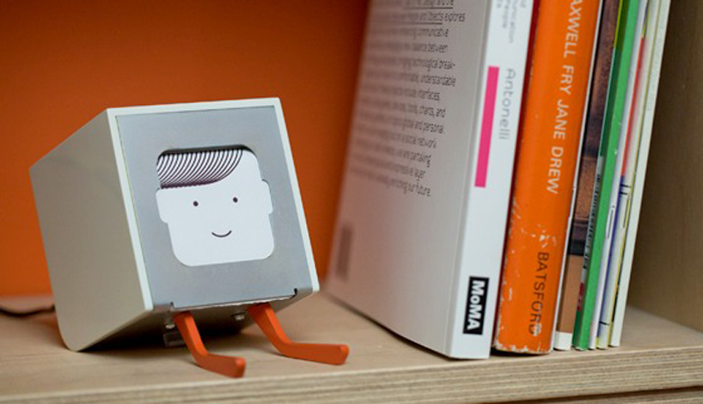
Technology with personality
BJ Fogg, “computers as social actors”
Physical: Face, eyes, body, movement
Psychological: Preferences, humor, personality, feelings, empathy, "I'm sorry"
Language: Interactive language use, spoken language, lan- guage recognition
Social Dynamics: Turn taking, cooperation, praise for good work, answering questions, reciprocity
Social Roles: Doctor, teammate, opponent, teacher, pet, guide

Slide 23
Other aspects of design
Ergonomics / human factors
Accessibility / universal design

Slide 24
What else do we need to know?
Guidelines/heuristics on good design
Standards and conventions
“When should buttons be on the top or the bottom of the screen?”
Example: Apple Human Interface Guidelines
User interface controls/toolkits
Example: Twitter Bootstrap, iOS controls

Slide 25
Heuristic evaluation

Slide 26
What’s a heuristic?

Slide 27
What’s a heuristic?
“experience-based techniques for problem solving, learning, and discovery that find a solution which is not guaranteed to be optimal, but good enough for a given set of goals.” (Wikipedia)
Examples: (http://c2.com/cgi/wiki?HeuristicRule)
Deciding to eat at restaurant B rather than restaurant A only because B has more cars in its parking lot
When the level in the fuel tank drops to 1/2 tank or less, always filling up the fuel tank at the very next re-filling station.

Slide 28
HE vs. user testing
When we can, we want to test with real users
HE is a “discount” usability technique
When it’s useful:
When real users are unavailable
Very early in the design
As a sanity check (but not a replacement for user testing)

Slide 29
Why HE is great
Cheap
Doesn’t “spend” users
Fast
1-2 days (instead of 1 week)
Good
Proven effective: the more careful you are, the better it gets
Easy to use
Relatively easy to learn, can be taught

Slide 30
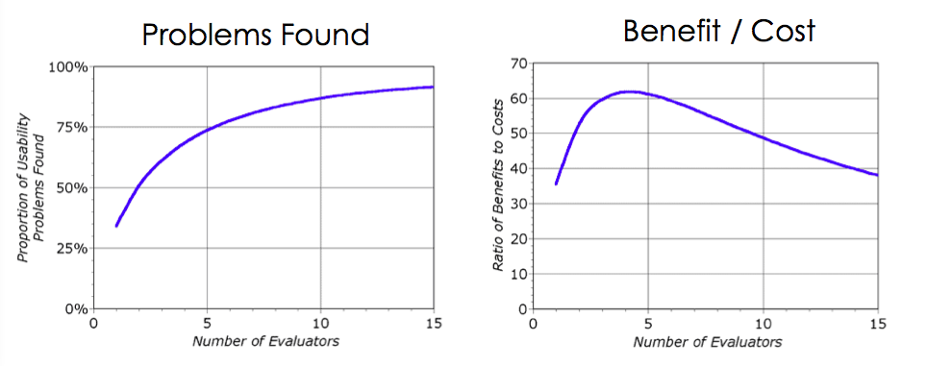
How many evaluators are needed?
Nielsen recommends at least 3, 5 even better
Notes:
http://www.nngroup.com/articles/how-to-conduct-a-heuristic-evaluation/

Slide 31
Phases of Heuristic Evaluation
0) Pre-evaluation training (optional)
Give evaluators needed domain knowledge & information on the scenario
Evaluate the interface to find usability problems
Record the problem
Aggregate problems
Assign severity rating

Slide 32
Which heuristics to use?
Many possible heuristic sets
Some standard sets (e.g. Nielsen’s usability heuristics)
You might create your own heuristics, e.g. for specific applications
We’ll focus on Nielsen’s, which cover a range of general usability issues

Slide 33
Find which heuristic is violated
Visibility of system status
Match between system and the real world
User control and freedom
Consistency and standards
Error prevention
Recognition rather than recall
Flexibility and efficiency of use
Aesthetic and minimalist design
Help users recognize, diagnose, and recover from errors
Help and documentation
http://www.nngroup.com/articles/ten-usability-heuristics/

Slide 34
Example of applying the heuristics
http://www.slideshare.net/sacsprasath/ten-usability-heuristics-with-example

Slide 35
Record the problem
No standard format (sometimes called Usability Aspect Reports or UARs)
Each usability problem (or feature) should be documented, and include
Descriptive title
Evaluator name
Location (or steps to reproduce)
A picture
Description of problem
Relevant heuristic
Severity (e.g., low, medium, high, critical)
Proposed solution
Notes:
How should we determine severity? (frequency, impact)

Slide 36
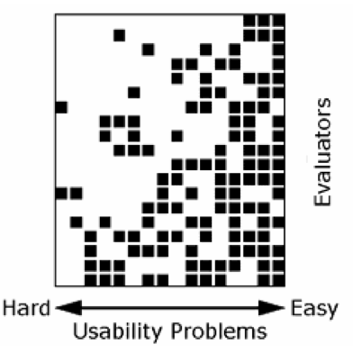
Keep looking for problems!
Usually takes a few hours
A shorter time may not find important problems
A longer time will exhaust the evaluator, and they may become less productive
For very large interfaces, it is good to break heuristic evaluation into several sessions
Notes:
Note in the chart that not all evaluators will find the hard problems, but they will tend to find the easy ones

Slide 37

What about multiple problems?
This happens a lot, record them separately.
This is not busywork….
It may be possible to fix some of the problems, but not all of them
The problems might not always be linked to each other – one may show up in other situations too

Slide 38
Nielsen’s Severity Ratings
Usability Blemish. Mild annoyance or cosmetic problem. Easily avoidable.
Minor usability problem. Annoying ,misleading, unclear, confusing. Can be avoided or easily learned. May occur only once.
Major usability problem. Prevents users from completing tasks. Highly confusing or unclear. Difficult to avoid. Likely to occur more than once.
Critical usability problem. Users won’t be able to accomplish their goals, and may quit using system.

Slide 39
False positives
There’s no virtue in finding 6,233 problems, if very few of them actually cause problems for a user
Every problem reported in a heuristic evaluation takes time for the developers to consider
Some interface aspects that seem like problems at first might not be problems at all

Slide 40
HE vs. User Testing
User tests are more effective at revealing when a system’s conceptual model is confusing
User tests are less effective at finding obscure problems
User tests are also much more expensive
Advice: use HE first, to find the obvious problems, then user test.

Slide 41
Practice
Let’s think of annoying usability problems
Notes:
Chrome crashes, loses my tabs
PeopleSoft: it lets me search and then tells me I can’t

Slide 42
Practice
Let’s think of annoying usability problems
Which usability heuristics are violated?

Slide 43
Next time
We’ll get started on Assignment 6 (heuristic evaluation) in class
Pair with one other student
Pick an interesting device or application to study

Slide 44
